Slide 1

WHAT THE DUCKS
Gabrielle O-G
Aysha Sparks
Livia Throckmorton

Slide 2
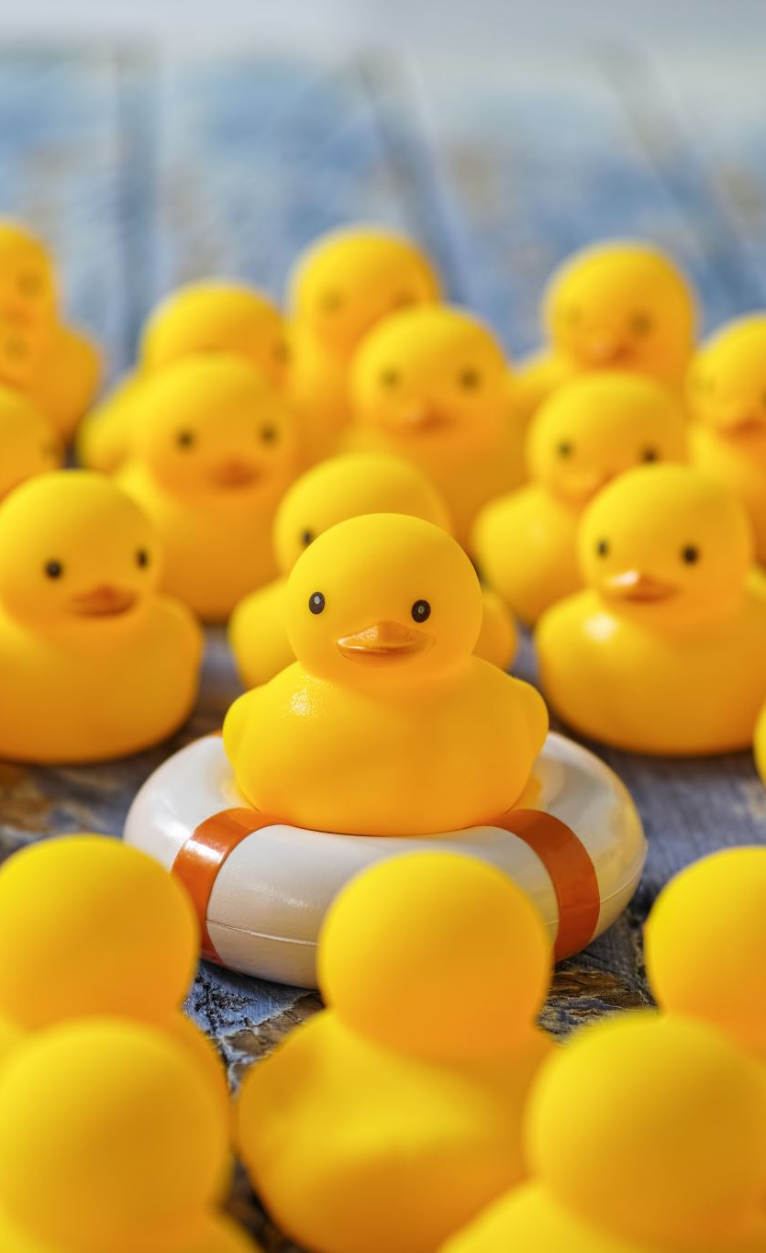
WHO WE ARE
At WHAT THE DUCKS, we harness creativity in the form of a fun dress up game. While much like other dress up games, Dress-Up Duck is where users can dress the duck with clothing items from its wardrobe.
We are strong advocates for instilling confidence in people, so we also have a Forum so users can share their outfits made and potentially comment on other users' ducks!

Slide 3
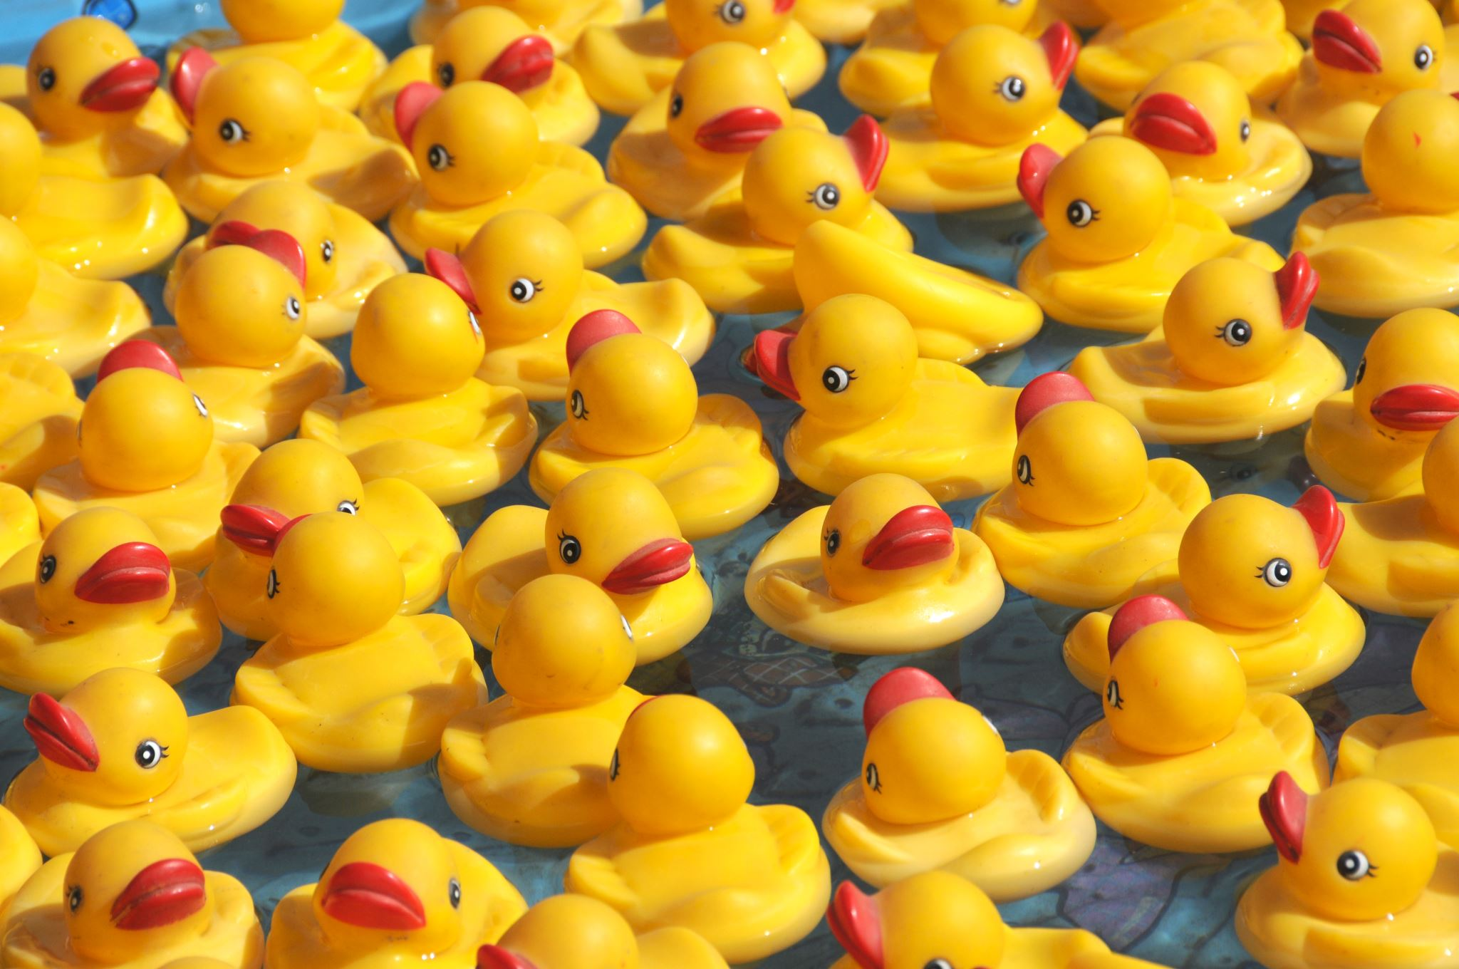
STUMBLING ACROSS PROGRAMMING

Slide 4
Programming ducks
We are a staff of 3 and while we all have varied backgrounds, coding brought us together to work on this awesome project. Gabrielle – whom is a nurse – wanted to pivot into a field that allowed her to maintain and utilize her critical thinking and problem-solving skills. Livia got her start in graphic design, in which she received her degree. After securing a Web Development certificate, Livia decided to pursue coding so she can expand her abilities. Aysha had dabbled in programming and coding when she was younger (coding MySpace and Blogger layouts was her jam!) but never took it seriously. It wasn't until the pandemic where she decided to pivot from using her Psychology degree in mental health to programming full time.

Slide 5
As far as I'm concerned, playing 'Dress Up' begins at the age of 5, and never truly ends.
“
”
Kate Spade

Slide 6

Dress Up Duck
Our project is Dress-Up Duck. We will be using a variety of technologies to get our achieved outcome, which is a functional, fun, safe environment to express creativity!

Slide 7
Technologies Used
React
Java
JavaScript
Greensock
Git
Docker
IntelliJ
VSCode
PhotoPea for .svgs
Node.js
(& programs)

Slide 8

Thank you to Corbin & Dillon for their exemplary patience for our learning

